Slide 1

Fine-grained Attention and Feature-sharing Generative Adversarial Networks for Single Image Super-Resolution
01
1.Motivation
2.Fine-grained Attention Networks
Photo-realistic
3. Feature-sharing Networks
4.Comparsions with state-of-the-art methods
5.Ablation Study
Notes:
GAN-based SR methods have been propose to generate photo-realistic images for super-resolution. But there are some issues in these GAN-based methods, for example，the discriminator only delivers the whole guidance to the generator and the shallow feature extraction parts of generator and discriminator are individual. Hence, we propose two novel techniques for the GAN-based SR methods: the Fine-grained Attention mechanism and Feature-sharing mechanism.

Slide 2
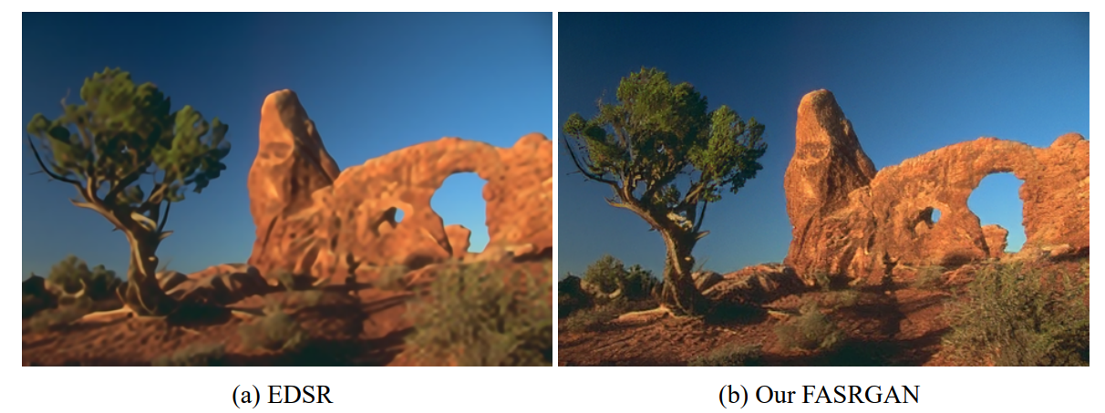
Motivation
Images produced by the MSE-based SISR neural networks are over-smoothed and blurry due to lack of high-frequency details
2
Notes:
Images produced by the MSE-based SISR neural networks are over-smoothed and blurred due to lack of high-frequency details. As the figure shown, the image produced by EDSR has high PSNR value but is blurry and over-smoothed. While the image produced by our FASRGAN is more photo-realistic and has more high-frequency features.

Slide 3
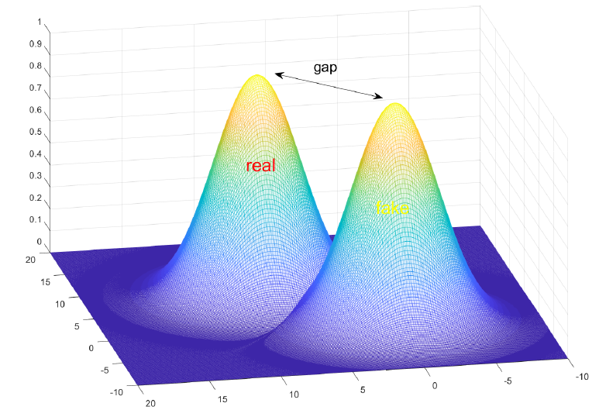
Generative Adversarial Networks
GAN is used to shrunk the gap between the distribution of generated image and that of the ground truth.
Notes:
The images generated by the pixel-based methods have difference in perceptual quality between the ground truth due to the gap between the distribution of generated image and that of the ground truth. Generator is used to decrease this gap.

Slide 4
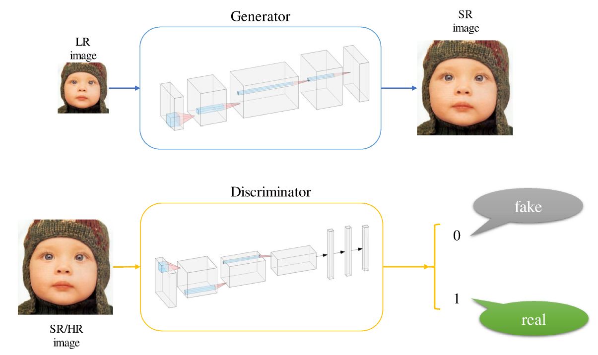
Generative Adversarial Networks
Notes:
The GAN-based SR methods contain two part: the generator and the discriminator. The generator need generate a SR image, while the discriminator need distinguish the input is the ground truth or generated image. The generator and the discriminator is a min-max problem, where the generator need generate SR image that can fool the discriminator. However, we find that there is a shortage, the discriminator gives a whole discrimination on the image, outputting 0 or 1. This manner is coarse, the generator cannot find out which part in the image is hard to recover.

Slide 5
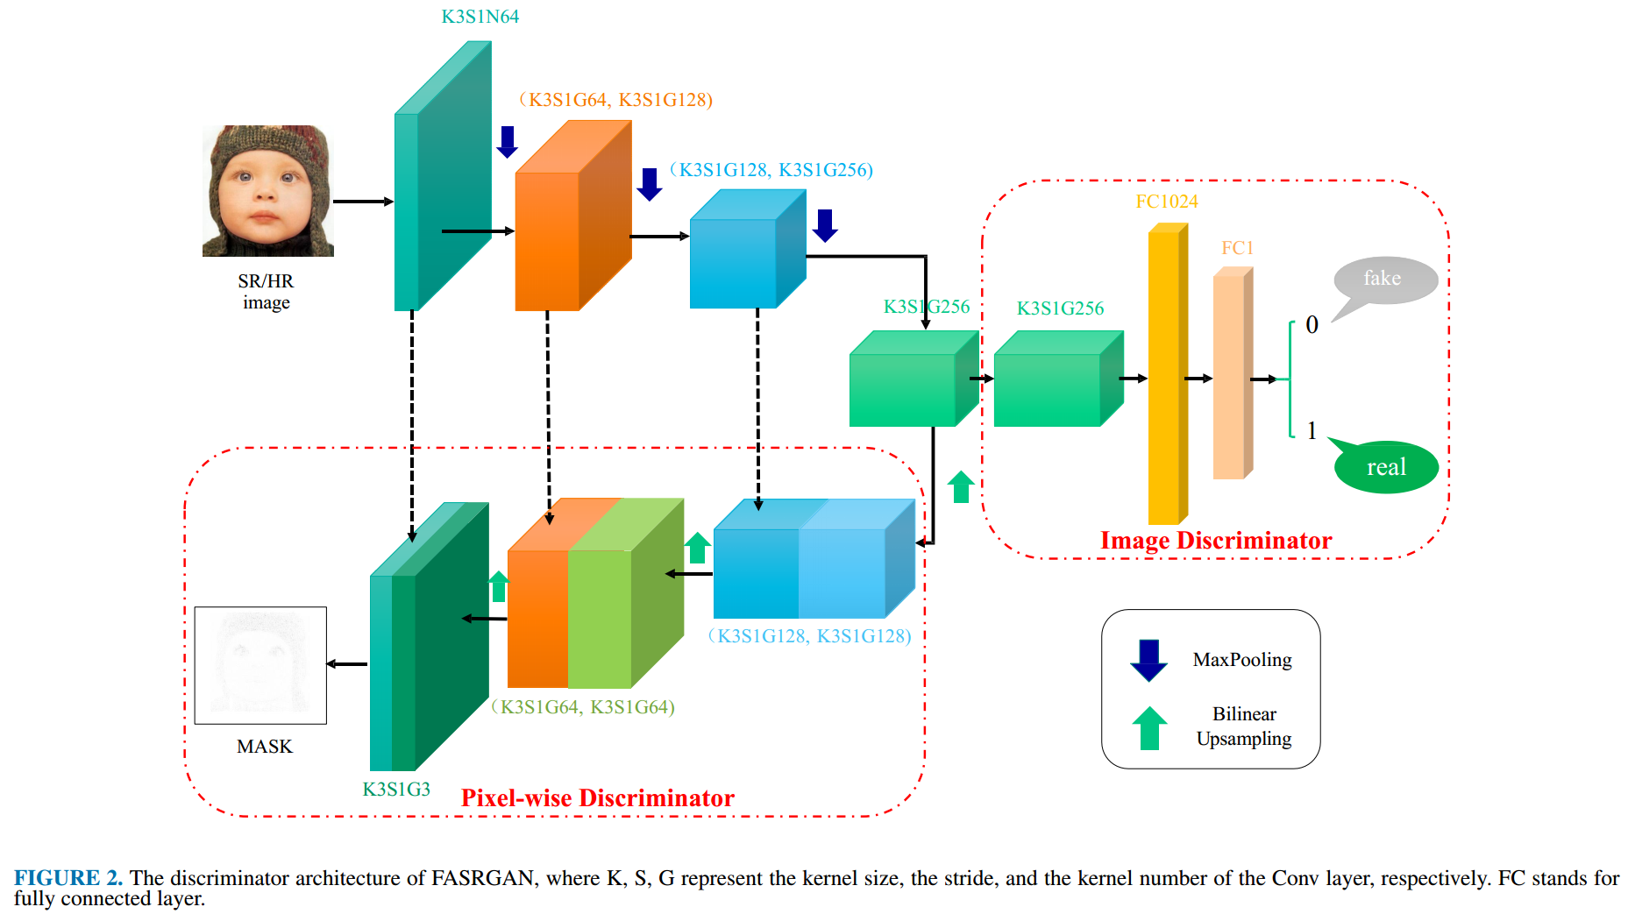
Fine-grained Attention Generative Adversarial Networks（FASRGAN）
Notes:
We propose the Fine-grained Attention Generative Adversarial Networks (FASRGAN), which supervises the generator in a fine-grained manner. We adopt a Unet-like structure as the discriminator, decreasing the feature map constantly and using fully connected layers to output a whole discrimination when the feature map is the smallest. Then we upsample the feature map, obtaining a fine-grained supervisor of discriminator. The mask is a score map and has the same size and channels as the input image. In addition, to fully use the fine-grained supervisor, we incorporate the score map as a fine-grained attention mechanism into the L_1 loss function.
The score map generated by the Unet-like discriminator is pixel-wise discrimination scores of an input image, with values M(w,h,c) among [0; 1]. A higher score means closer to a real image, otherwise closer to a fake one. In this manner, the score map can indicate which parts of an image are more difficult to be generated and which parts are easier. For instance, the structure background part of an image is sometimes simpler, and thus it would expect the discriminator reflect this to update the generator.

Slide 6
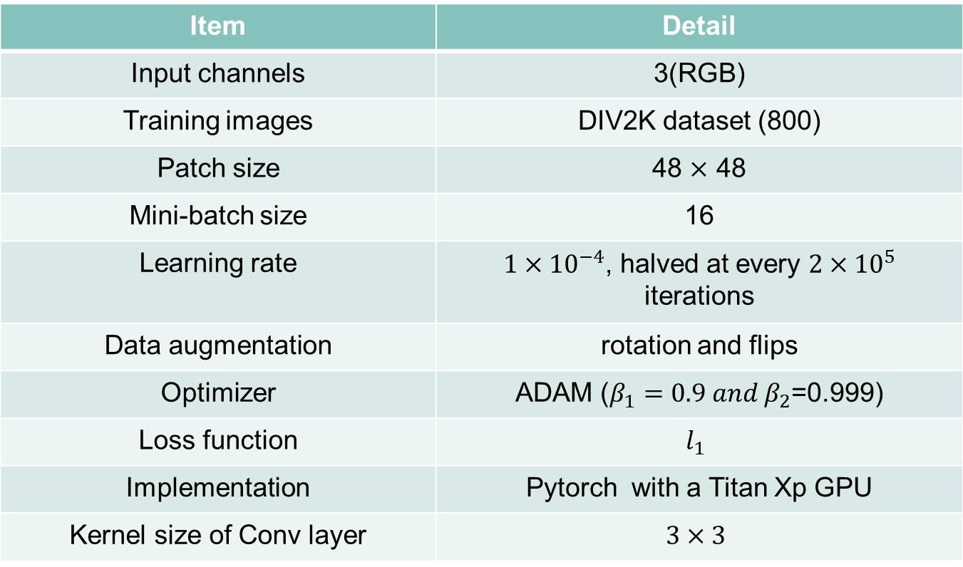
Experiment Setting
Item | Detail
Input channels | 3(RGB)
Training images | DIV2K dataset (800)
Patch size | 48 $×$ 48
Mini-batch size | 16
Learning rate | $1×{10}^{−4}$, halved at every $2×{10}^{5}$ iterations
Data augmentation | rotation and flips
Optimizer | ADAM ($β_{1}=0.9 and β_{2}$=0.999)
Loss function | $$l_{1}$$
Implementation | Pytorch with a Titan Xp GPU
Kernel size of Conv layer | $$3×3$$
Notes:
The form contains the experiment settings of our two methods.

Slide 7
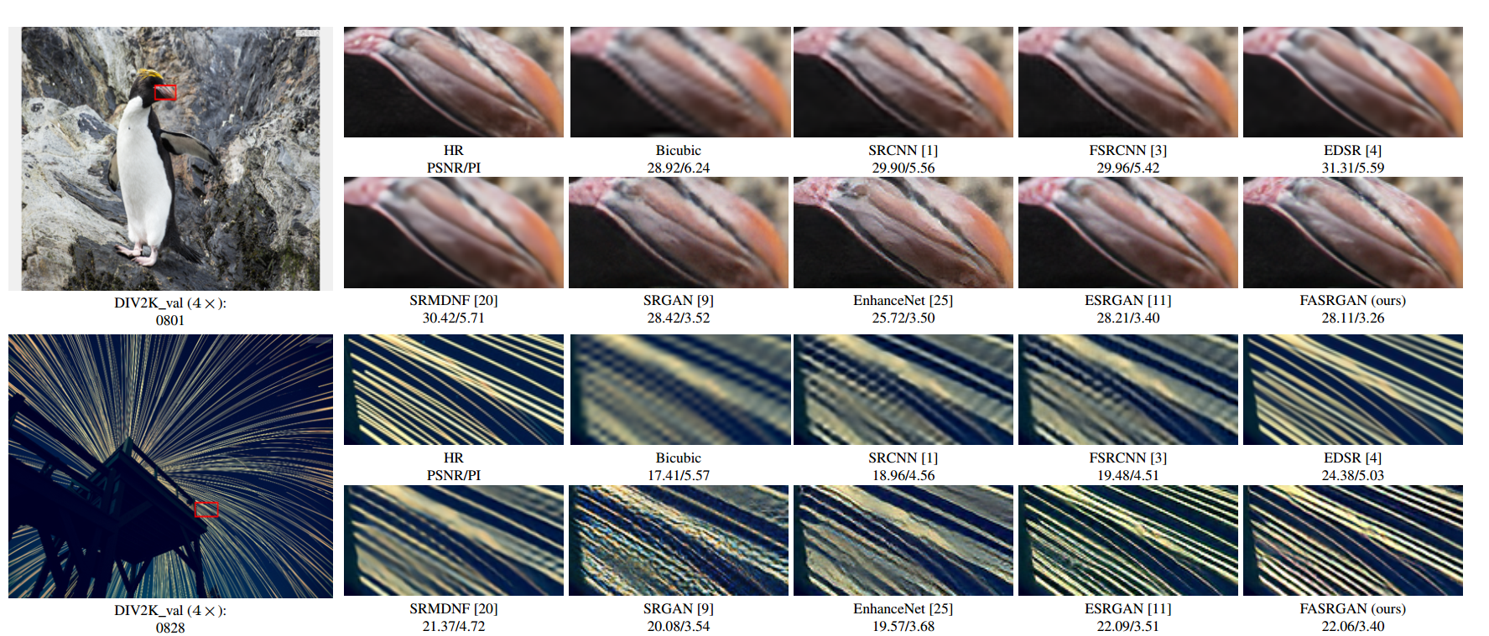
Visual Comparison of FASRGAN
Notes:
We compare our final models on several public benchmark datasets with state-of-the-art SR methods.
On image ’0801’ of DIV2K, MSE-based methods tend to generate blurry results, while results from SRGAN and EnhanceNet tend to be noisy; results from ESRGAN are blurry and over-smoothed edges. FASRGAN can produce sharper and more natural textures of the penguin beak. The cropped parts of image ’0828’ are full of textures. As we can see, all the compared MSE-based methods suffer from heavy blurring artifacts, failing to recover the structure and the gap of the stripes. SRGAN, EnhanceNet, and ESRGAN generate high-frequency noise and wrong textures; while our FASRGAN can recover them more correctly, producing more faithful results and being closer to the HR images.

Slide 8
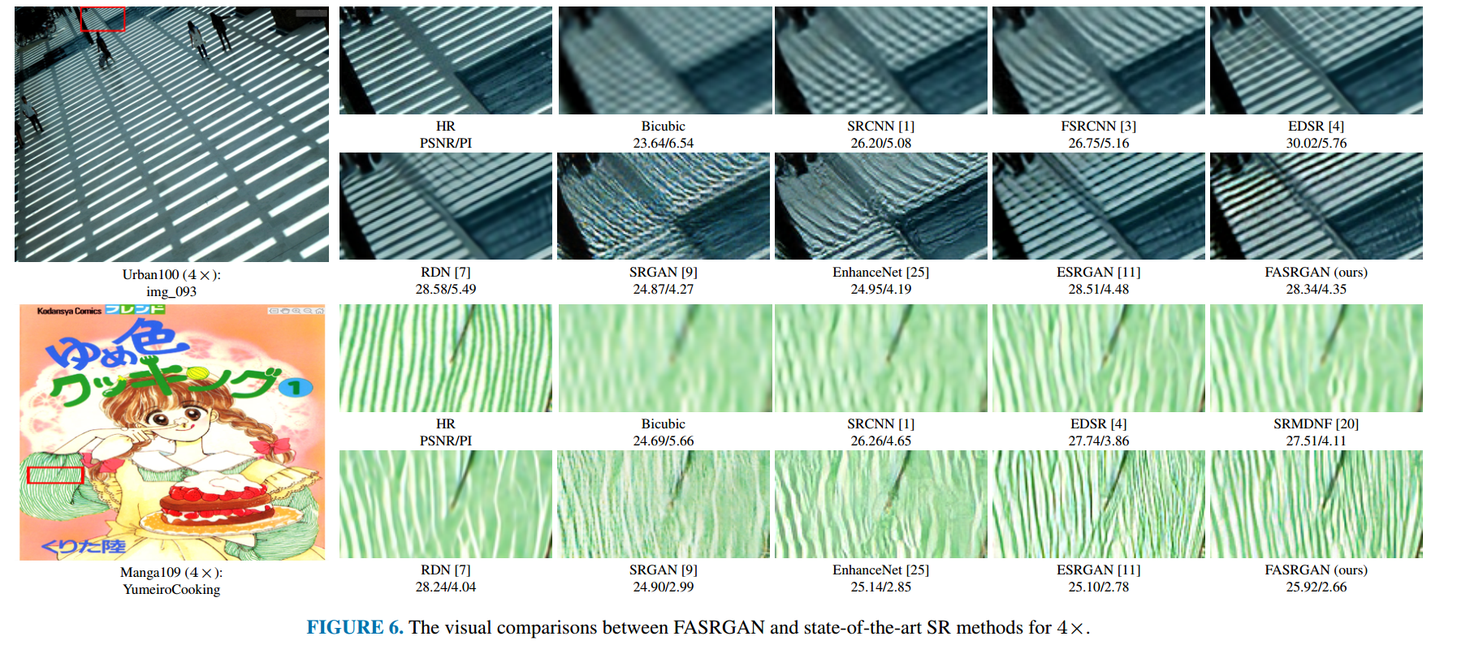
Visual Comparison of FASRGAN
Notes:
For image ’img_093’, the cropped part of the image generated by the compared methods contains heavily blurring artifacts and lines with wrong directions. By contrast, our FASRGAN can alleviate the artifacts better and recover zebra crossing with correct structures. These comparisons demonstrate the strong ability of FASRGAN for producing more photo-realistic and high-quality super-resolution images.

Slide 9
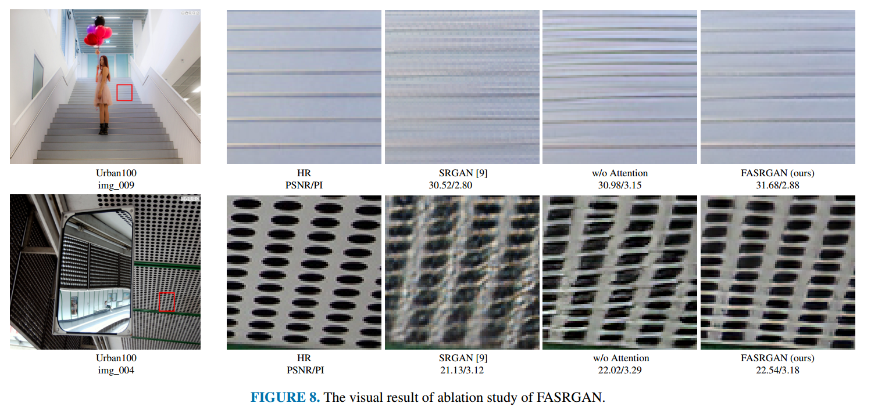
Ablation Study
Notes:
In order to demonstrate the effectiveness of our fine-grained attention mechanism, we conduct the ablation study on FASRGAN by removing the FA mechanism.
For image ’img_009’, the model without FA mechanism introduces some unnatural noise and undesired edges, while FASRGAN can maintain the structure and produce highquality SR images. For image ’img_004’, the FA mechanism can improve the deformation appeared in the image from the model that removes the FA mechanism. The images generated by FASRGAN are closer to the original HR images. The visual analysis indicates the effectiveness and benefit of the FA mechanism in removing unpleasant and unnatural artifacts.

Slide 10
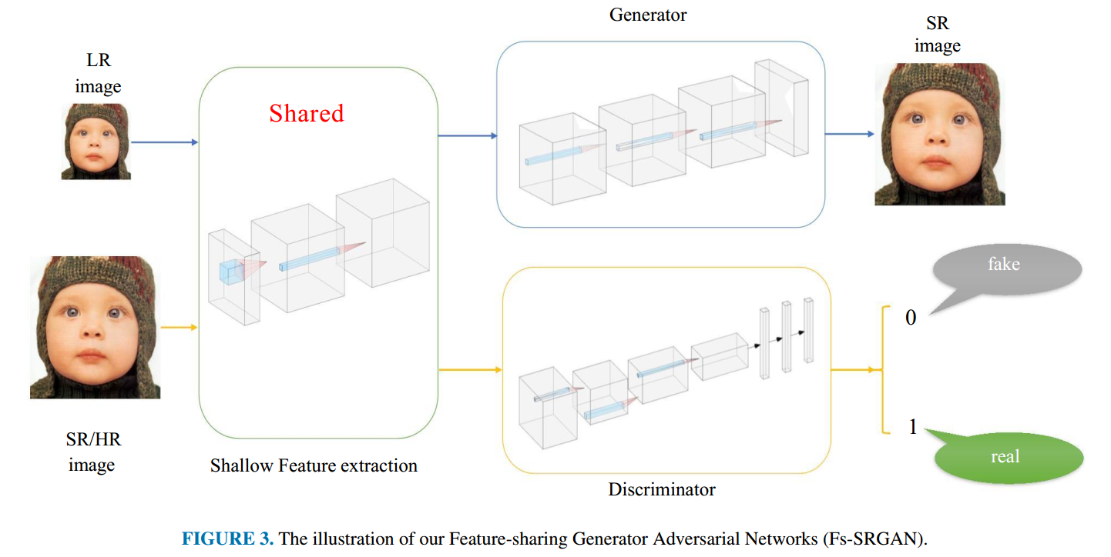
Feature-sharing Generative Adversarial Networks(Fs-SRGAN)
Notes:
In standard GANs, the generator and the discriminator are usually defined as two independent networks. In our problem, we argue that the shallow parts of these two networks always extract local textures such as edges and corners. To reflect this, we propose to share the shallow-feature-exaction parts of the generator and discriminator. The rest of the generator and discriminator are similar to ESRGAN.
The feature-sharing mechanism allows the generator and discriminator to jointly optimize the shallow feature extractor. Similar to FASRGAN, we adopt RRDB as the basic structure. The shared feature extractor contains E RRDBs to extract helpful feature maps for both generator and discriminator. This reduces the number of model parameters and helps the generator and discriminator extract more useful features, which can improve model performance

Slide 11
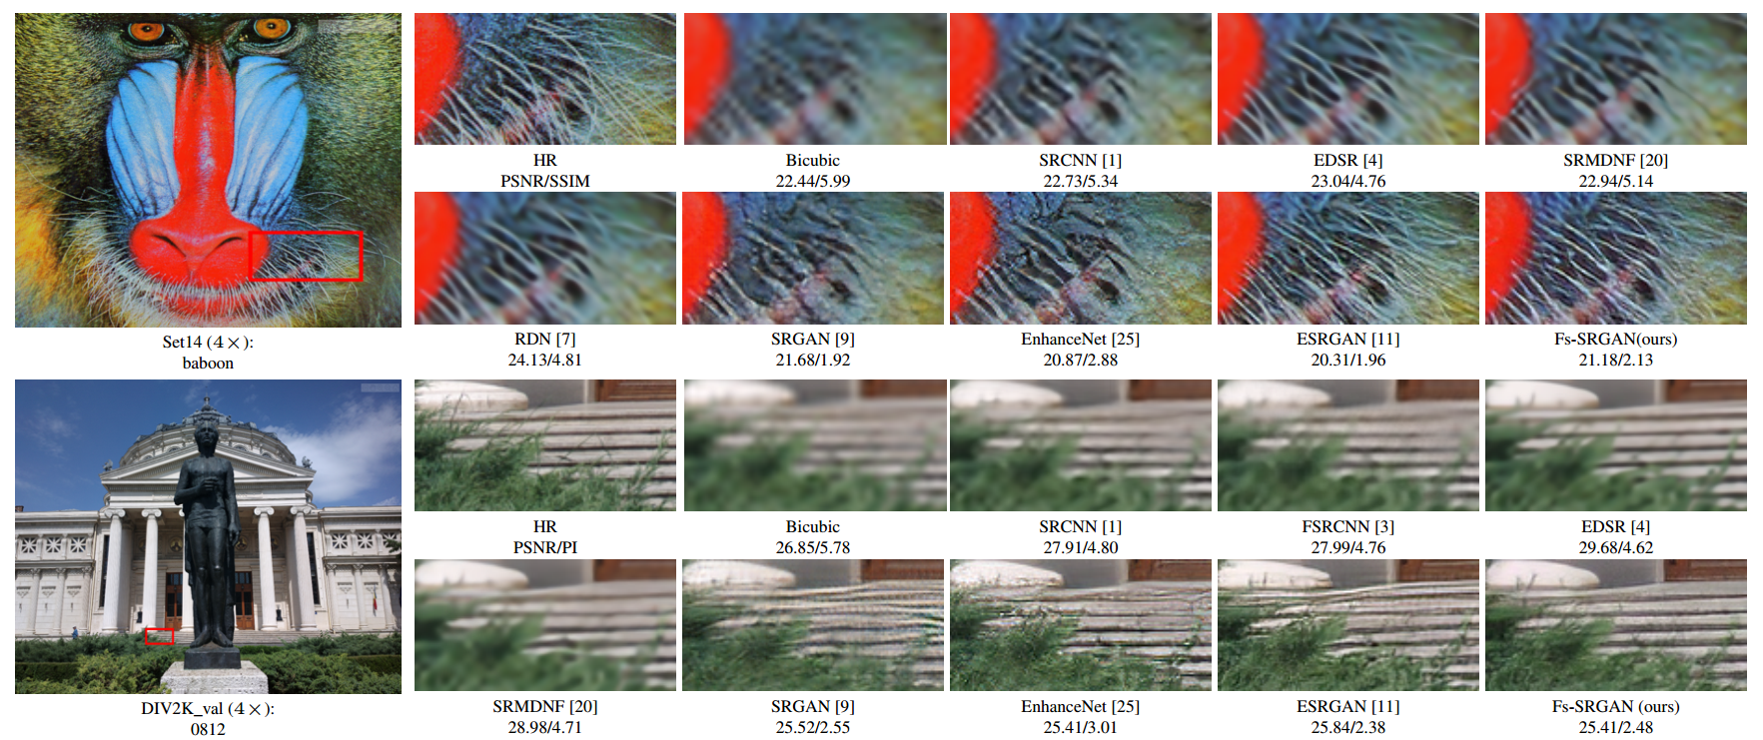
Visual Comparison of Fs-SRGAN
Notes:
Obviously, our Fs-SRGAN obtains better performance than other methods in producing SR images, in terms of sharpness and details.

Slide 12
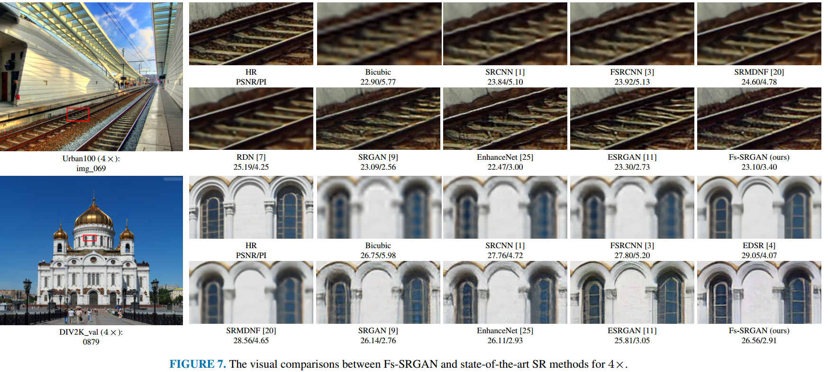
Visual Comparison of Fs-SRGAN
Notes:
For image ’0879’, our Fs-SRGAN can recover tiny textures of windows that look more natural, while previous methods still have difficulties to produce high-quality SR images. This also indicates that sharing shallow feature extraction parts of the generator and discriminator is beneficial

Slide 13
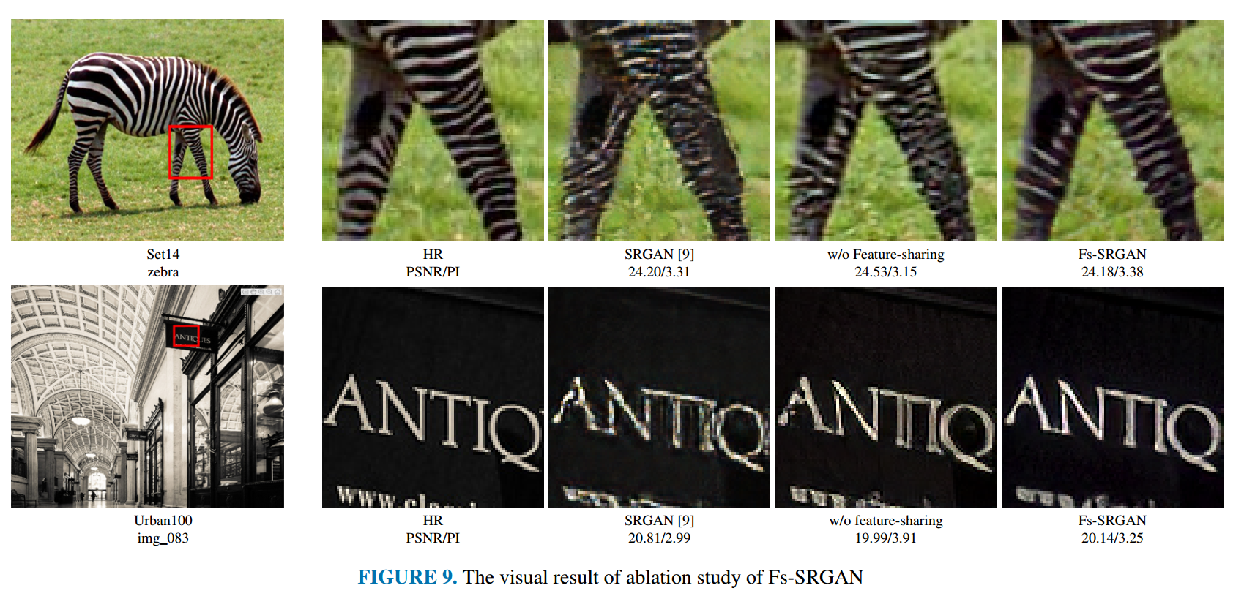
Ablation Study
Notes:
In order to demonstrate the effectiveness of our feature-sharing mechanism, we conduct the ablation study on Fs-SRGAN by removing the Fs mechanism.
We can observe that Fs-SRGAN outperforms SRGAN and the model without Fs mechanism by a large margin. The removal of feature-sharing mechanism tends to introduce unpleasant artifacts.

Slide 14
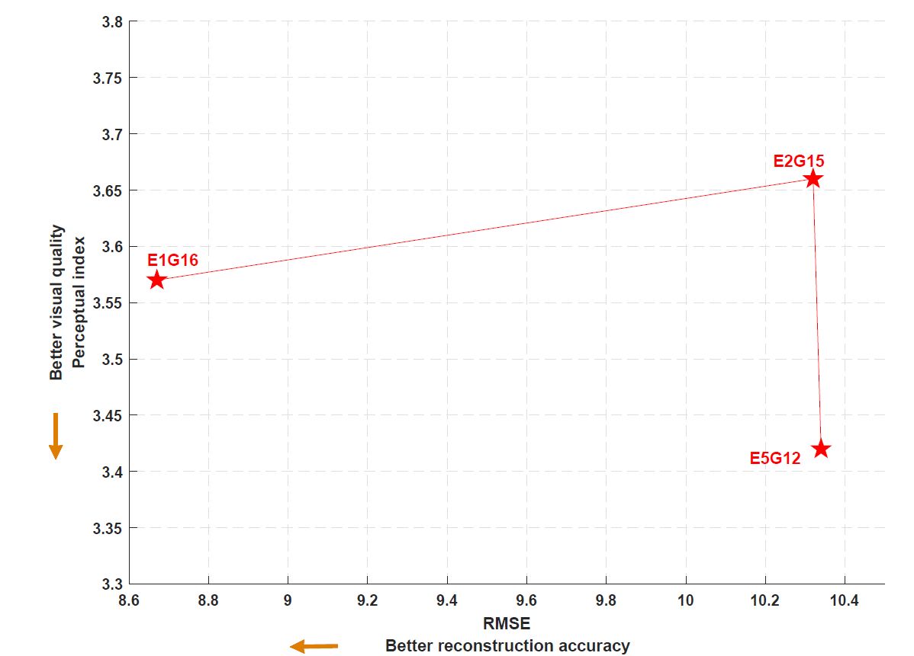
Ablation Study
Notes:
To further study the effect of the depth of the shared parts in Fs-SRGAN, we vary the number of RRDBs in the shared shallow feature extractor and deep feature extractor. As shown in Fig. 10, increasing the number of shared part from 1 to 2 decreases the performance, which is mainly manifested in the reconstruction accuracy. However, when the number is increased to 5, the model called E5G12 performs better in visual qualities

Slide 15
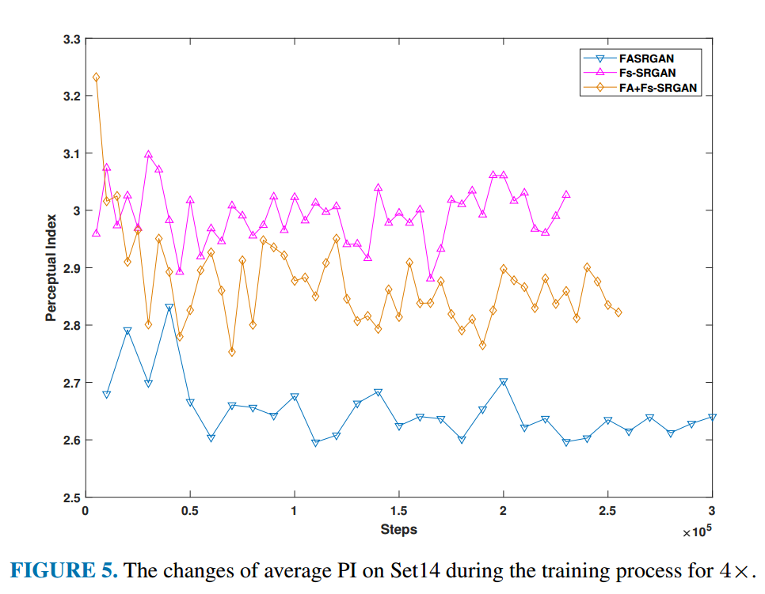
Change of PI value
Notes:
Fig 5 plots the curve of PI values in the training process of our proposed methods on Set14. We observe that the training process of FASRGAN is more stable and obtains better perceptual quality. The average PI value of Fs-SRGAN is higher than FASRGAN.

Slide 16
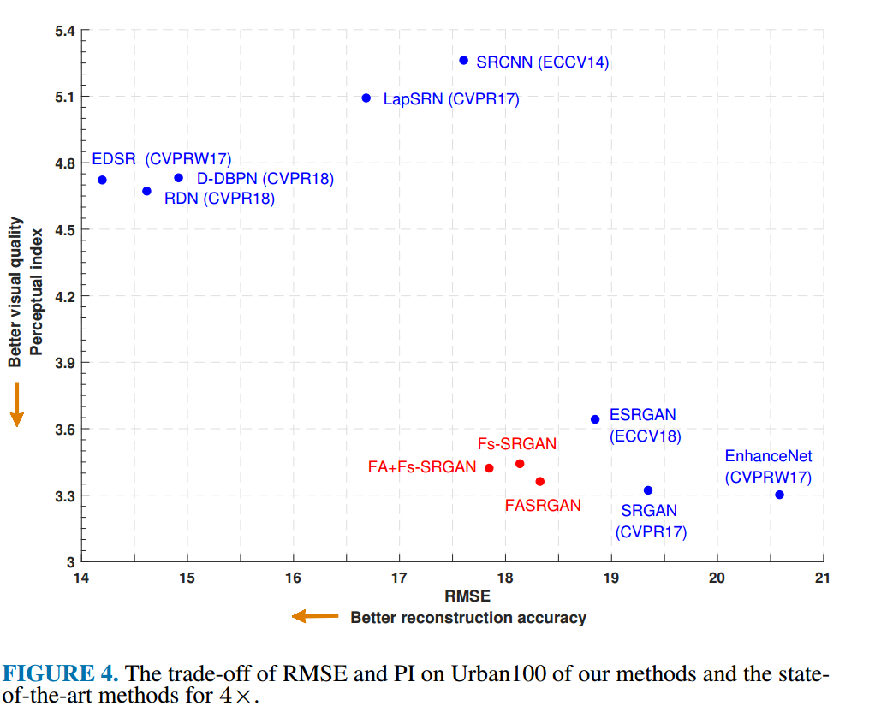
Quantitative Comparisons
Notes:
We also present the quantitative comparisons between our methods and state-of-the-art methods. These methods can be roughly divided into two parts: the top-left part and bottom-right part. Methods in the top-left part are almost MSEbased, which obtain low RMSE loss and high PI scores due to the over-smoothed edges and lack of high-frequency details. While SRGAN, EnhanceNet, ESRGAN, and our methods are all GAN-based methods. These methods usually gain high-visual quality images even if their RMSE losses are larger than those of the MSE-based methods. Among these methods, our FASRGAN and Fs-SRGAN get better visual quality and less reduction error. The FA+Fs-SRGAN attains the best reconstruction accuracy among all the GAN-based methods. FA+Fs-SRGAN also achieves a lower PI value

Slide 17
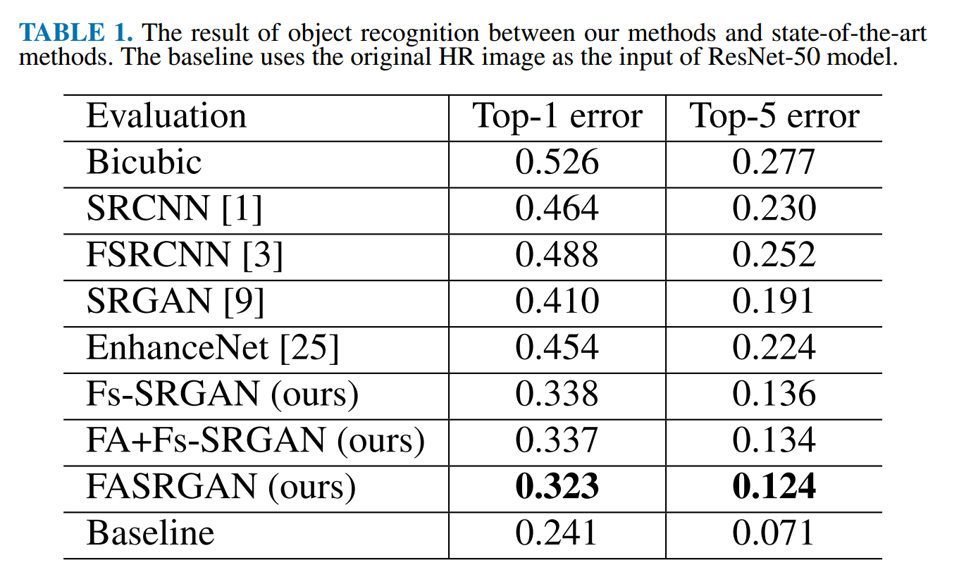
Object Recognition Performance
Notes:
To further demonstrate the quality of our generated SR images, we treat them as a pre-processing step for other high-level computer vision tasks such as object recognition, image classification and so on. We use the pre-trained ResNet-50 on imageNet as an evaluation model and fetch the first 1000 images in ImageNet CLS-LOC validation dataset for evaluation. The test images are firstly down-sampled by bicubic and then upscaled by our methods and the compared methods.
Among these three methods, FASRGAN achieves the lowest Top-1 and Top-5 errors, demonstrating the effectiveness of both the fine-grained attention and feature-sharing mechanisms

Slide 18
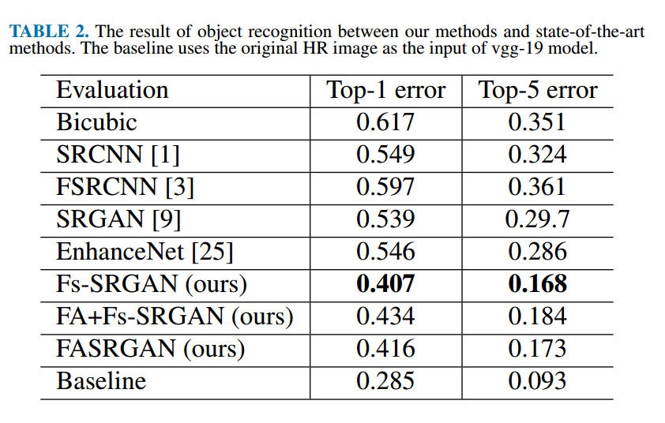
Object Recognition Performance
Notes:
To further illustrate the effectiveness of our models, we use another pre-trained model on imageNet, called vgg-19.
Among the SR methods, our models still obtain better results, and Fs-SRGAN achieves the lowest Top-1 and Top-5 errors

Slide 19
Thank You

